Slide 1
Flow-2 AI Execution Report
Report Deck Template | [Account] · [Role] · Option [N] · [Date]
Replace bracketed placeholders and add legible, redacted evidence.

Slide 2
Executive summary
Task: [chosen option and objective]
Outcome: [deliverable and value]
Credits used: [actual / 250]
Key learning: [one insight about directing AI]
Flow-2 AI Execution Report
1
Notes:
Summarize the project and final results.

Slide 3
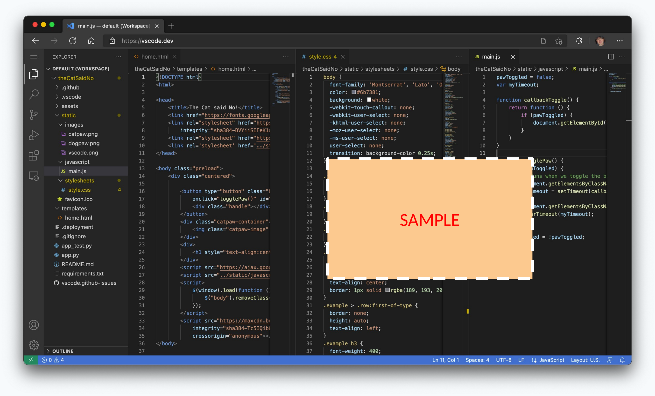
Output Evidence
Example: completed source code
Flow-2 AI Execution Report
9
Notes:
Walk through the real artifact.

Slide 4
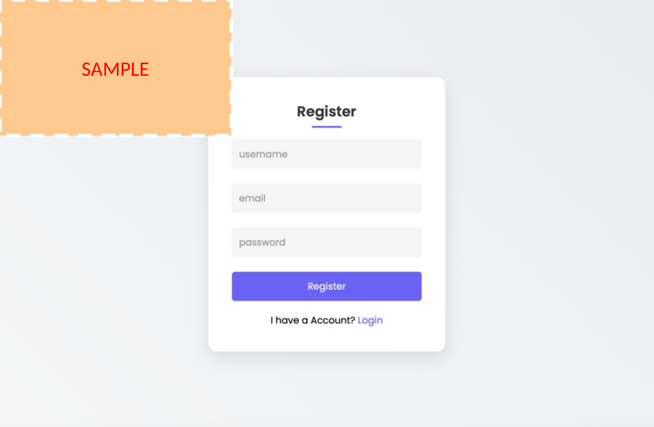
Output Evidence
Example: App UI
Flow-2 AI Execution Report
9
Notes:
Walk through the real artifact.

Slide 5
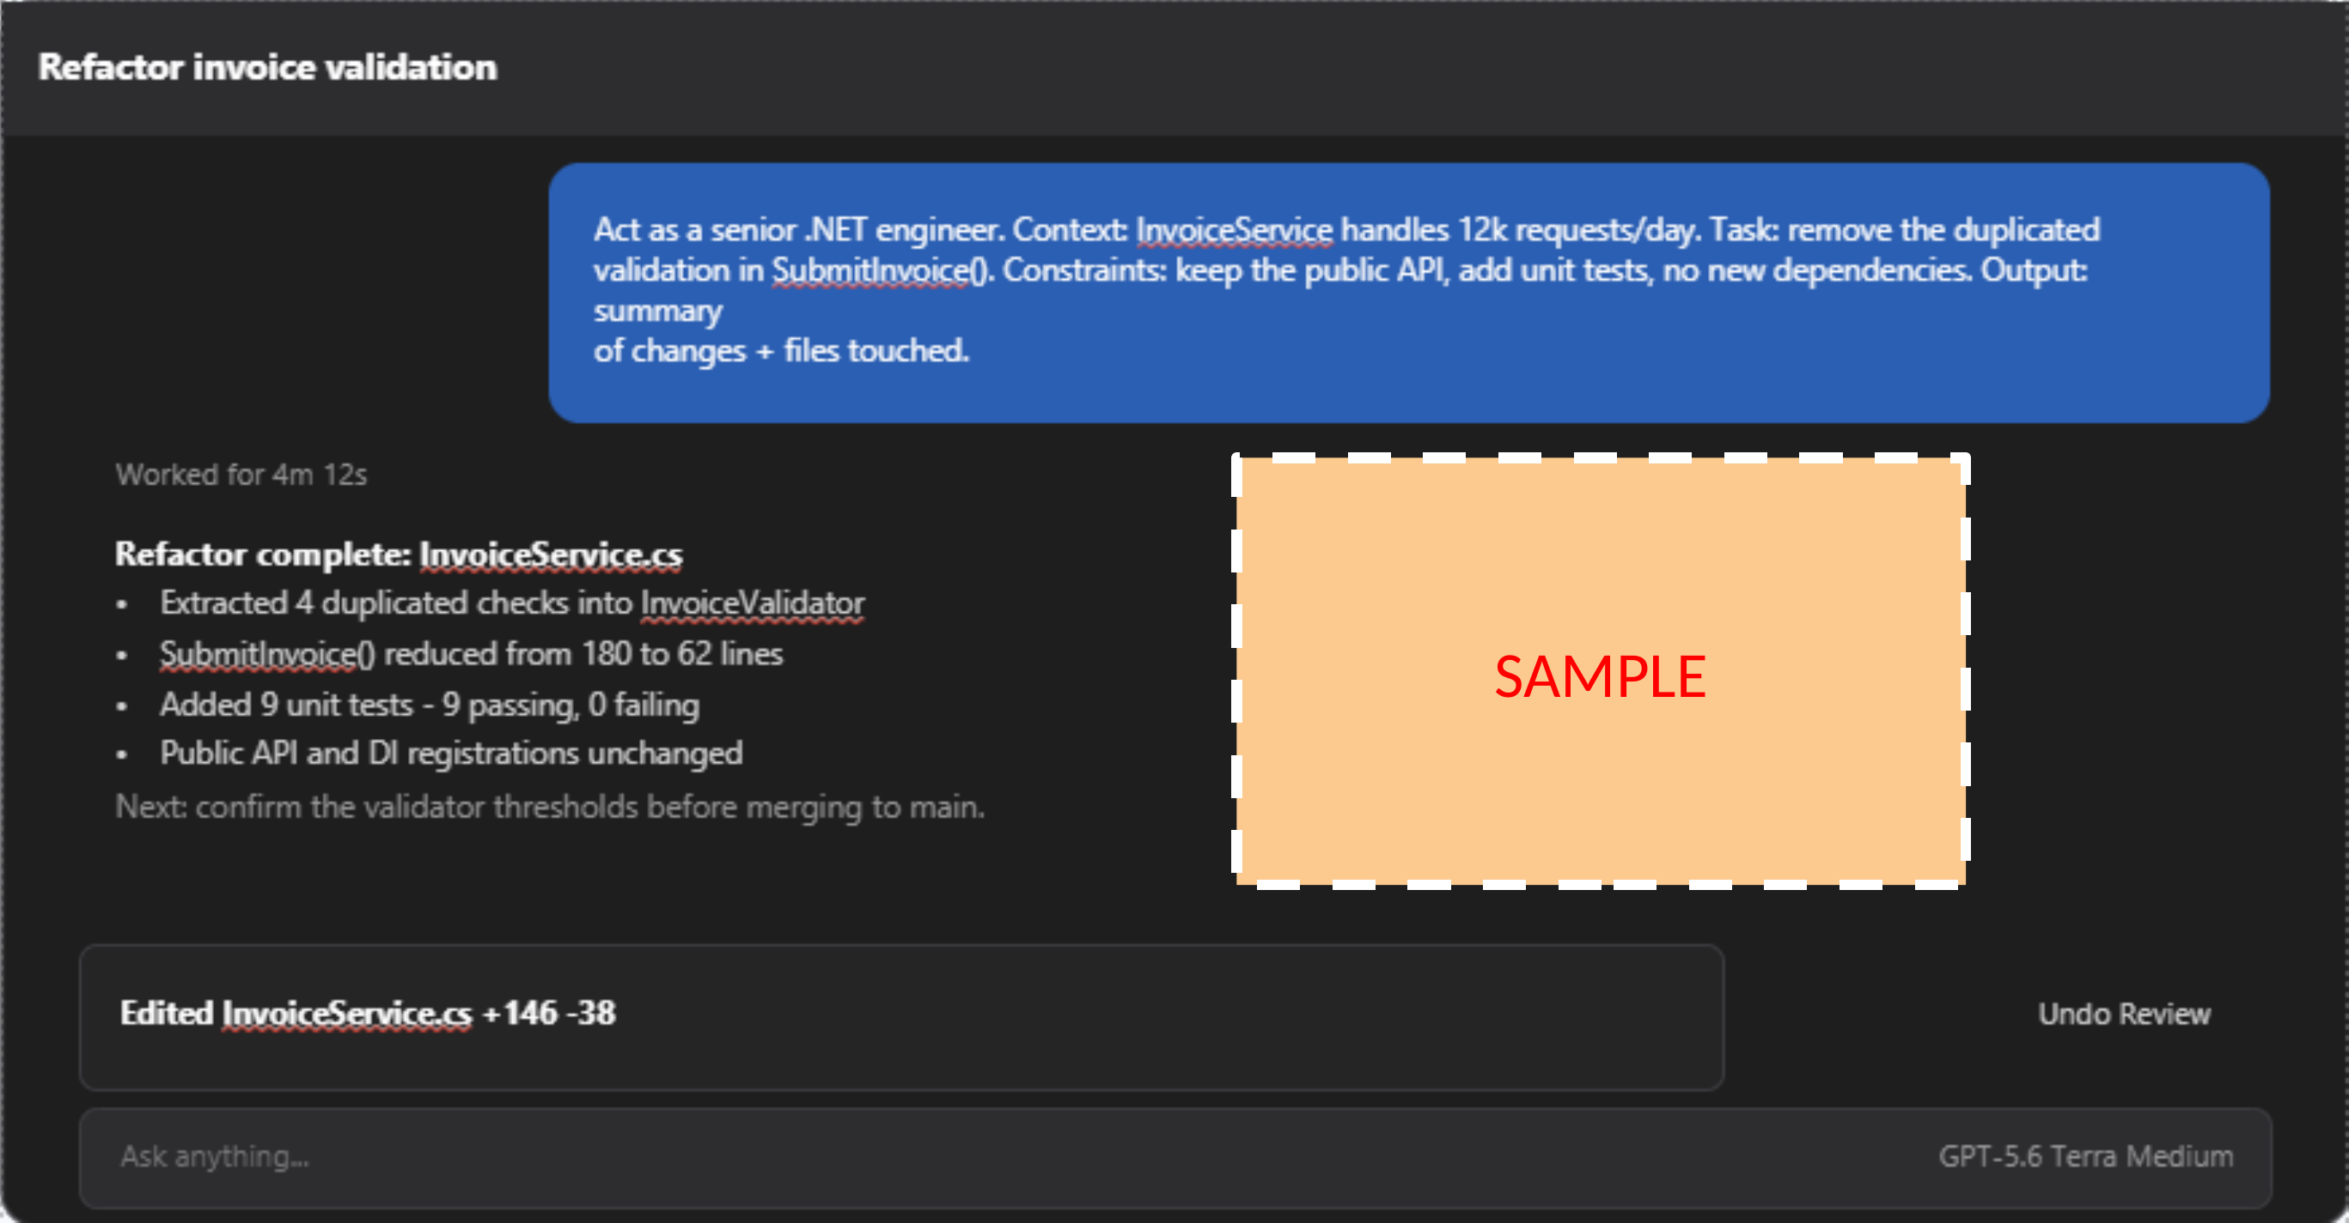
AI Chat
Example chat session – structured prompt and the agent’s executed actions (add more slides for entire chat sessions)
Undo Review
Flow-2 AI Execution Report
4
Notes:
Paste one representative prompt verbatim and explain its structure.

Slide 6
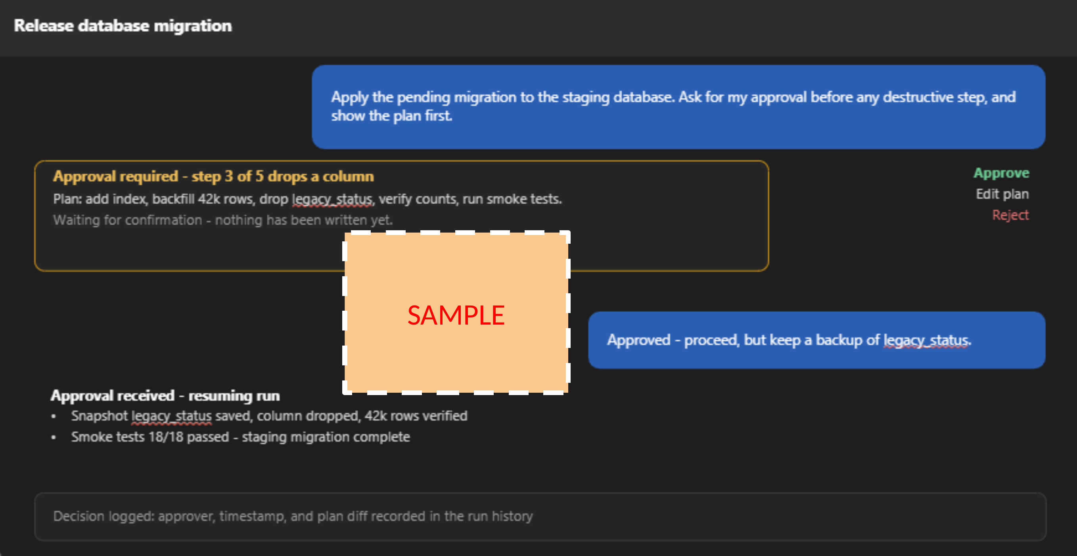
AI Chat
Example session – the agent pauses for human approval before a destructive step
Flow-2 AI Execution Report
6
Notes:
Make your sign-off visible.

Slide 7
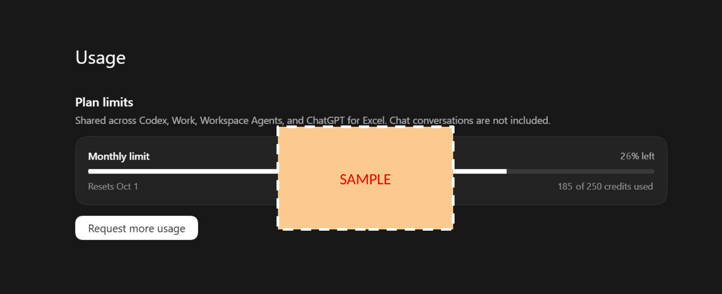
Credit/Token after the task is completed
Flow-2 AI Execution Report
12
Notes:
Report actual consumption and meaningful spending decisions.

Slide 8
Reusable workflow (Optional)
1. [Trigger / input]
2. [Prompt and context preparation]
3. [AI action with chosen mode/model]
4. [Human review gate]
5. [Verification and hand-off]
Reuse conditions: [real-project applicability]
Flow-2 AI Execution Report
14
Notes:
Turn the work into a repeatable governed workflow.

Slide 9
MCP usage proof (Optional bonus)
Server: [name]
Tool call: [name]
Input: [redacted summary]
Result: [outcome]
Evidence: [screenshot/log]
Value: [why it improved the task]
Flow-2 AI Execution Report
15
Notes:
Complete only if an MCP was actually used.

Slide 10
Final self-check
Every option requirement is satisfied and evidenced.
3+ visible examples show AI correction or rejection.
Mode, model tier, and MCP choice are justified.
Every substantive chat session is labelled and submitted.
Screenshots are readable and sensitive data is redacted.
Credit use is reported; no out-of-scope model was used.
Flow-2 AI Execution Report
16
Notes:
A pass requires 70+ and no Level 1 criterion.

